Slide 1


Relocation Basics on Complex Parcels
Shawna Shuffett, HMB
Tony Moore, KYTC CO
Mary Beth Johnson, Palmer
Notes:
SS – Intro

Slide 2
You’ve been assigned the Relocation Agent, what now?
Gather information – Acquisition Stage Relocation Report (ASRR)
  How many Relocations
  Type of Relocations
  Other Projects/Natural Disaster
  Project Timeline
Examples and how they were handled
Notes:
SS
What types –
RES – OWNER VS TENANT
PP Only
Nonres PP Only
Business
How many, any issues, etc
Floods & tornadoes
Whats the projected letting/ROW clearance

Slide 3




Residential Relocation
Owner Occupant -Replacement Housing Payment
Purchase Supplement
Incidental Expenses
Mortgage Differential
Tenant Occupant – Replacement Housing Payment
Rental Supplement
Down Payment Assistance
Move Expenses
Notes:
SS
New move estimate law

Slide 4

Residential Owner Occupant
Communication
Limits on where comps can be located
Bought a commercial zoned building in a commercial area
Notes:
SS
Early and often with bank and displacee
Early and often communication allows it to be paid at closing*

Slide 5
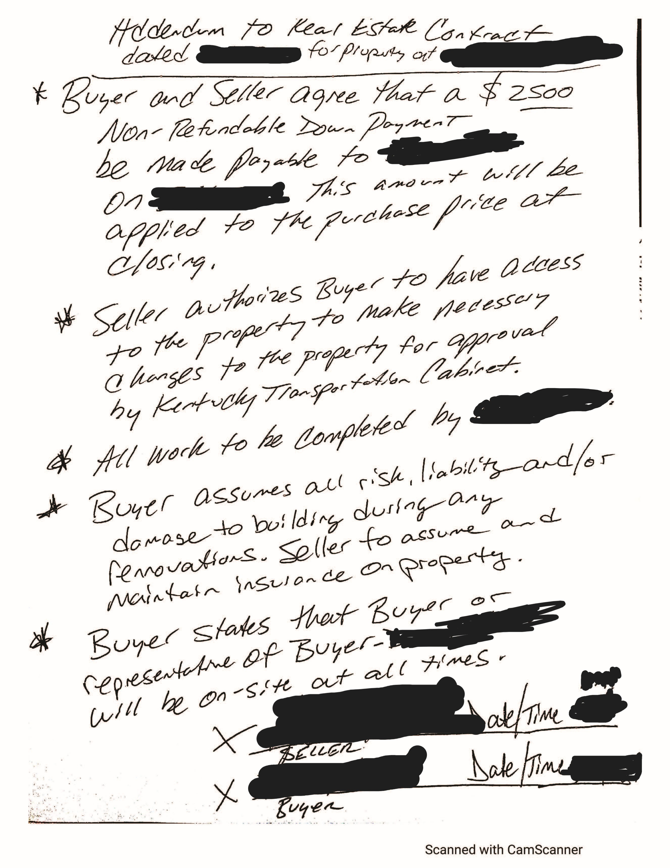
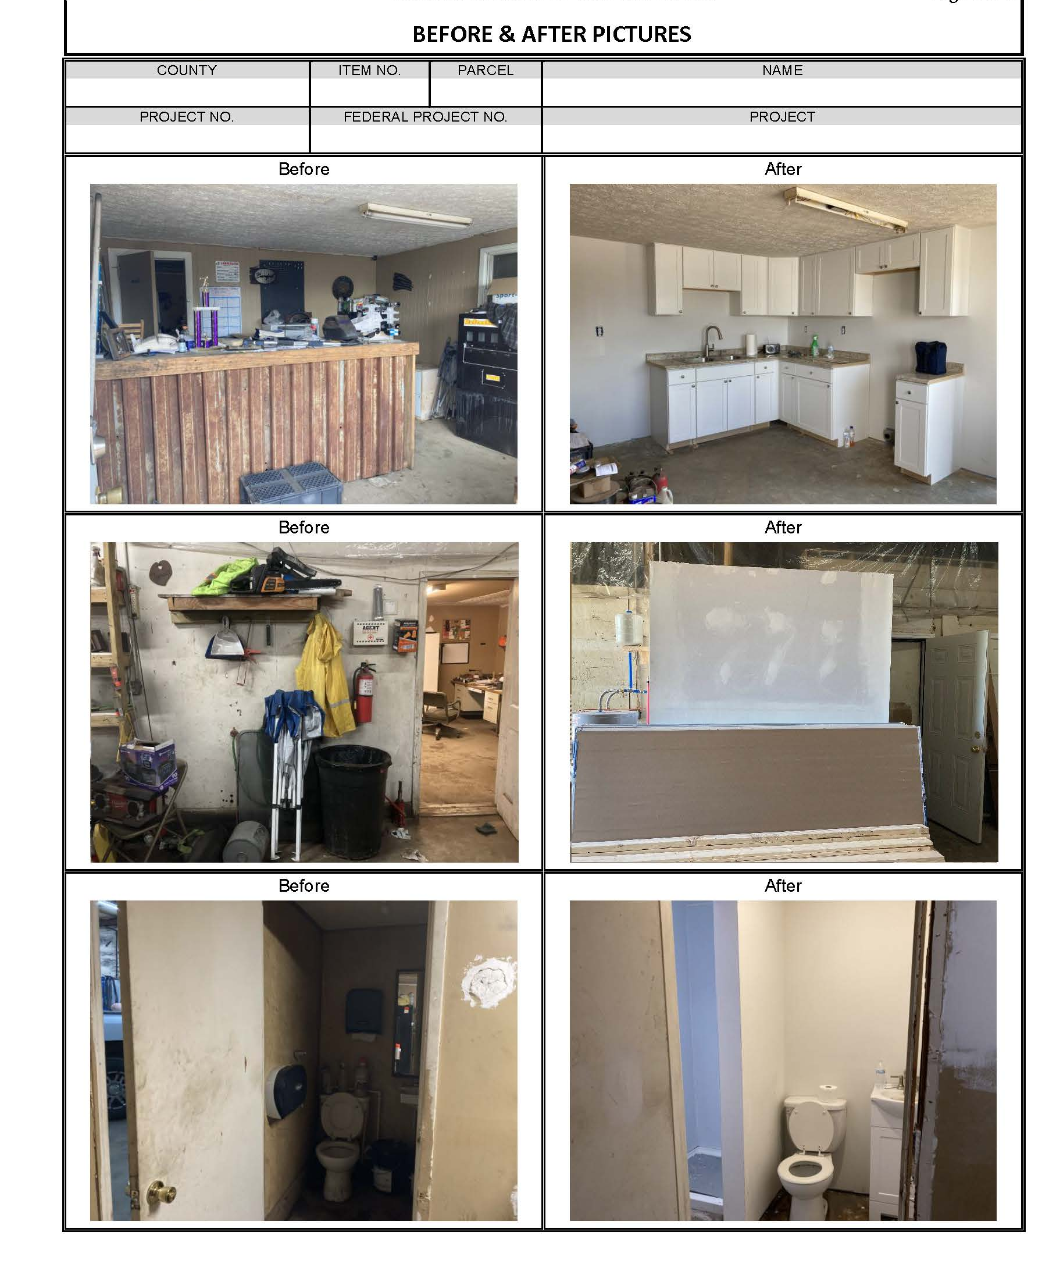
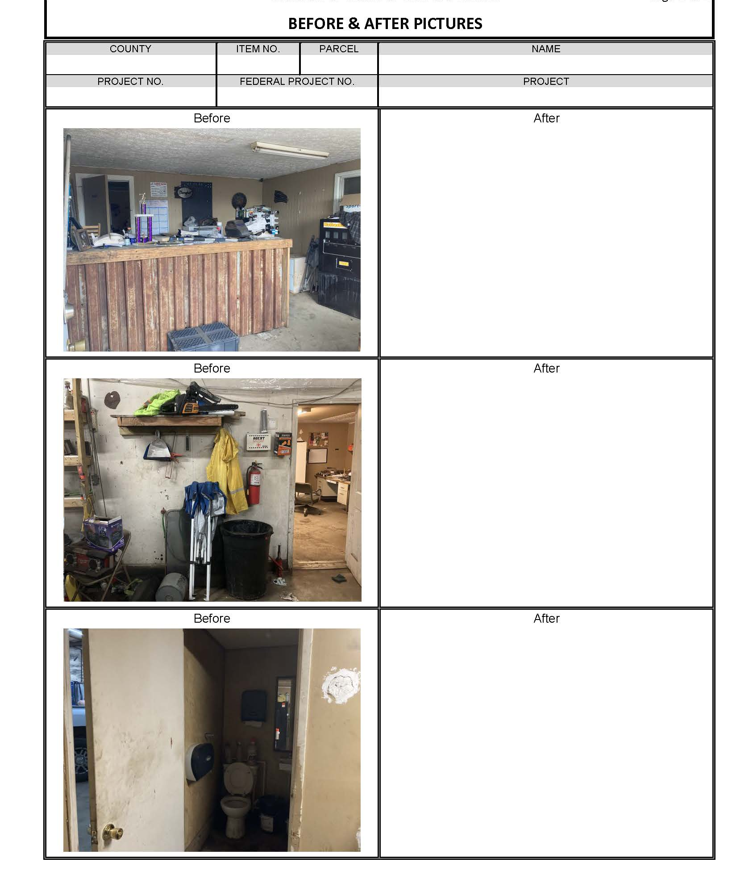
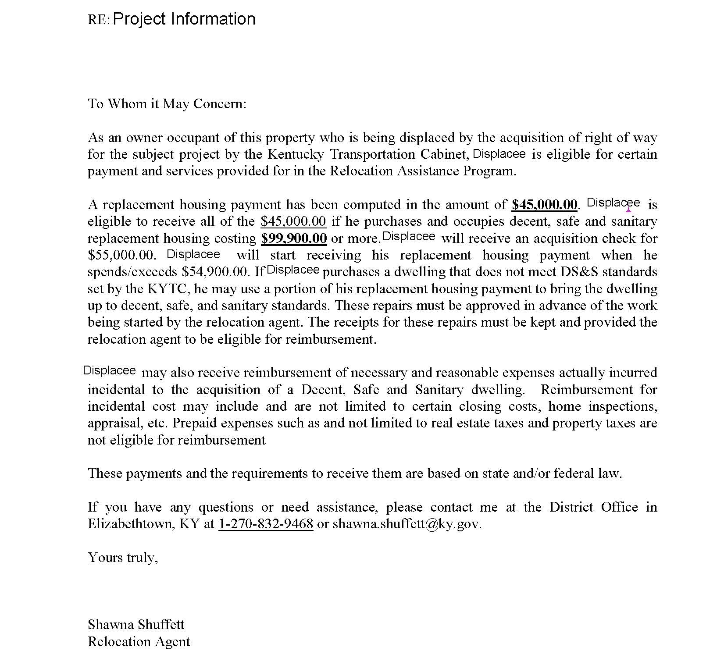
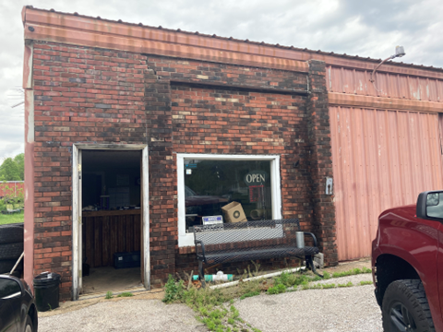
Notes:
SS

Slide 6


Mortgage Differential Payments
Communication - Early and Often
Buy Down & Points
Notes:
SS
Have bank redo loan

Slide 7
Business - Fixed Payment
Change of business style – Store Front to Remote
Tax Returns – COVID Impact
  Add in Net Earnings
Notes:
MB
Office equipment repair business and supply company. Had been at the location approximately 2 years. Inventory consisted of numerous pieces of office equipment, office supplies and years of “stuff”. Move estimate was obtained for $11,000. They were moving more to a remote operation rather than a store front. They would not qualify for reestablishment as the business was going remote. Asked the owners for their tax returns to see if a fixed payment in lieu of move/reestablishment would maximize their relocation assistance. Net earnings for both years prior to the year of displacement were a loss, due to covid. However, the business was a corporation and the program allows for the compensation of the officers to be added to the net earnings. This resulted in the net earnings to increase and resulted in a fixed payment to the business in the amount of over $30,000.00. The company chose the fixed payment option and were able to relocate the business to their planned remote operation.

Slide 8
Nonresidential Move Expense
Electrical Supply Company
34,000 inventoried items
Move Companies to perform the Estimate
Notes:
MB
An electrical supply company located in northeastern Kentucky with over 34,000 items in inventory. Move was very complex. After obtaining a detailed certified inventory, I started contacting move companies to obtain estimates. There was not a move company in the immediate area capable nor qualified to perform the move. I contacted move companies in the next largest city (Lexington) and none were interested in providing the bid as they stated the city was not in their service area. I reached out to companies in Louisville, again none were interested in providing bids as the city was not in their service area. I contacted a branch of North American Movers in Winchester and luckily one of the estimators who I worked with when I was with KYTC was still there. I explained the move and requested a bid. They were able to provide a bid for the move estimate. Still being a bid short, I contacted a moving company in Cincinnati. I explained the request for a bid, they declined as the city was not considered in their service area. He provided my contact information to a friend who worked for a different moving company in Cincinnati and they were interested in coming down to view the inventory and providing a bid.

Slide 9
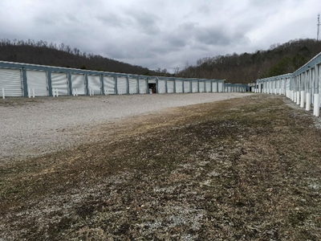
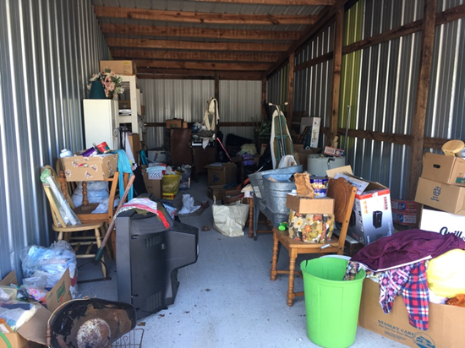
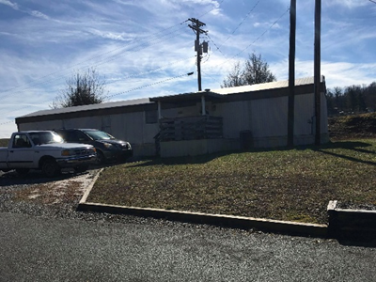
Multi-Use Property
Business
Personal Property
Residential Tenant
Notes:
SS

Slide 10
Realistic Project Timeline for Projects with Relocation
2 weeks
30 days
90 days
30 days
2 weeks
5 months
4-6 months + 30 days
3 weeks
10 days/2 weeks
10 day/2 weeks
35 days/ 4 weeks for work
4 months Total
ASRR- Property owner interviews
Appraisal complete
Purchase supplement computation
Offers – Relo & Acquisition offers
Purchase/closing
Move
Relocation
*Condemnation*
Advertise
Accept/Post Bond
Actual Demo
Demolition
9 months if relocation is involved with structures from time appraisal is received
9 MONTHS
To
18 MONTHS
DAQ
Notes:
TM

Slide 11



Q&A
Notes:
SS
New move estimate law

